Slide 1
ECE 532
CHAPTER 1: REVISION OF COMPUTER PROGRAMMING CONCEPT (FUNCTION PART 1)
Lecturer: Dr. Roslina Mohamad
Room: Tower 2, Level 13, No: 14C
Tel: 03-55436068

Slide 2
Learning Outcomes
FUNCTION
PART 1 – PASS-BY-VALUE FUNCTION
1)VOID FUNCTION
2)VALUE-RETURNING FUNCTION

Slide 3
Learning Outcomes
At the end of this lecture, you will be able to:
Revise how to construct and use a value-returning, void, user-defined function in a program
Revise the concept of pass-by-value function

Slide 4
Introduction
Functions are like building blocks
They allow complicated programs to be divided into manageable pieces
Some advantages of functions:
A programmer can focus on just that part of the program and construct it, debug it, and perfect it
Different people can work on different functions simultaneously
Can be re-used (even in different programs)
Enhance program readability

Slide 5
User-Defined Functions
Value-returning functions: have a return type
Return a value of a specific data type using the return statement
Void functions: do not have a return type
Do not use a return statement to return a value

Slide 6
Prototyping, Calling and Defining Functions
Function prototype: a function declaration statement
Function call: a statement that causes a function to execute
Function definition: the statements that make up a function

Slide 7
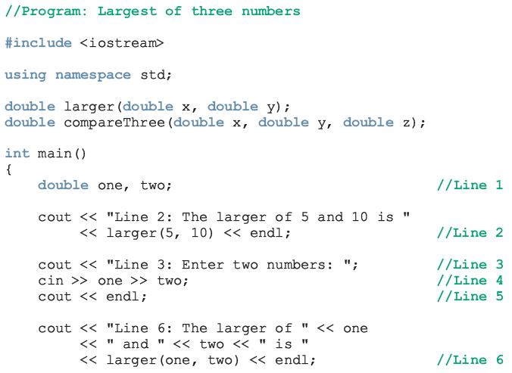
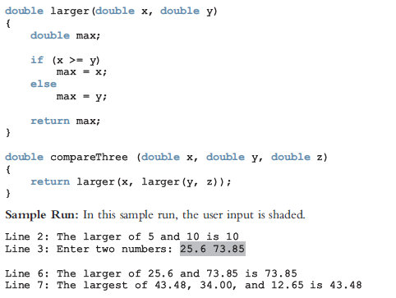
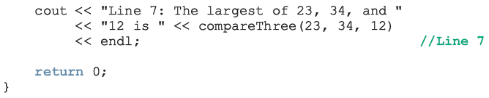
Example of Function
Function
Prototype
Function
Call

Slide 8
Example of Function
Function
Definition

Slide 9
Function Prototype
Function prototype: function heading without the body of the function
Syntax:
It is not necessary to specify the variable name in the parameter list
The data type of each parameter must be specified

Slide 10
Calling a Function
To call a function, use the function name followed by () and ;
printHeading();
When a function is called, the program executes the body of the function
After the function terminates, execution resumes in the calling module at the point of call
Format Function Call

Slide 11
Calling Functions with Multiple Arguments Illustration
displayData(height, weight); // call
void displayData(int h, int w)// heading
{
cout << "Height = " << h << endl;
cout << "Weight = " << w << endl;
}

Slide 12
Function Definition
Definition includes
return type: data type of the value the function returns to the part of the program that called it
name: name of the function. Function names follow same rules as variable names
parameter list: variables that hold the values passed to the function
body: statements that perform the function’s task

Slide 13
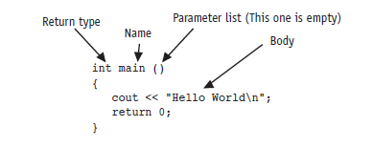
Function Definition

Slide 14
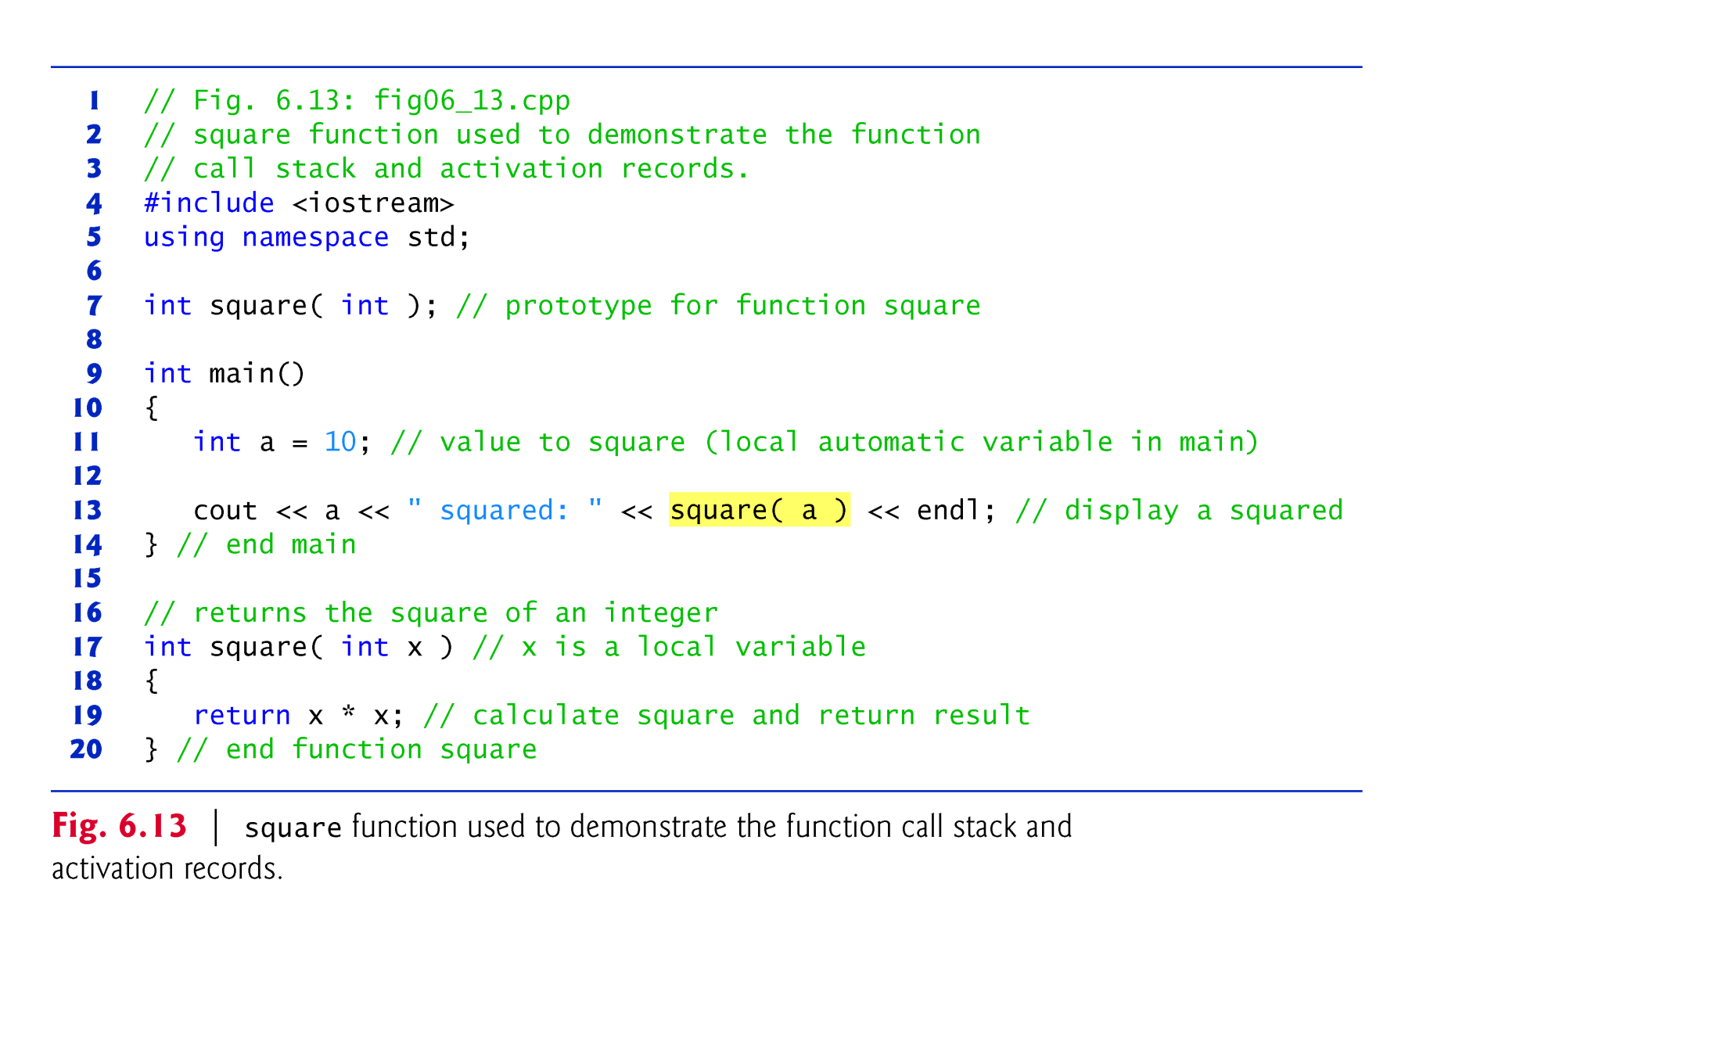
Example using a Function Prototype
//See Example 1.19

Slide 15
Example using a Function Definition (without Function Prototype)
#include<iostream>
using namespace std;
int square(int x) // Function Definition
{
return x*x;
}
int main()
{
int a=10;
cout<<a<<" squared: "<<square(a)<<endl;
}
//See Example 1.20

Slide 16
Void Function (Non-return Type) & Function Return Type
If a function does not return a value, its return type is void
void printHeading()
{
cout << "\tMonthly Sales\n";
}
If a function returns a value, the type of the value must be indicated
int main()

Slide 17
PASS-BY-VALUE FUNCTION
When an argument is passed by value, a copy of the argument’s value is made and passed (on the function call stack) to the called function.
Changes to the copy do not affect the original variable’s value in the caller.

Slide 18
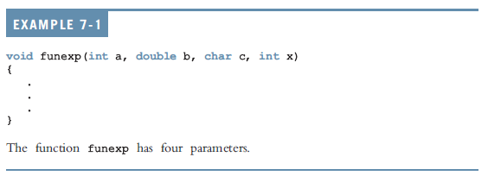
Void Functions

Slide 19
Example of Void Functions with no Parameter (Refer to Gaddis)
Program without using function prototype
//See Example 1.21, Example 1.22,
Example 1.23, Example 1.24
Program using function prototype
// See Example 1.25

Slide 20
Example of Void Functions with a Parameter(s)/ Pass-by-Value (Refer to Gaddis)
// See Example 1.26, Example 1.27, Example 1.28, Example 1.29

Slide 21
Passing Data by Value
Pass by value: when an argument is passed to a function, a copy of its value is placed in the parameter
The function cannot access the original argument
Changes to the parameter in the function do not affect the value of the argument in the calling function

Slide 22
Passing Data by Value
Example: int val = 5;
evenOrOdd(val);
evenOrOdd can change variable num, but it will have no effect on variable val
val
num
5
5
argument in
calling function
parameter in
evenOrOdd function

Slide 23
Value-Returning Functions with Passing by Value
To use these functions you must:
Include the appropriate header file in your program using the include statement
Know the following items:
Name of the function
Number of parameters, if any
Data type of each parameter
Data type of the value returned: called the type of the function

Slide 24
Value-Returning Functions with Passing by Value
Because the value returned by a value-returning function is unique, must:
Save the value for further calculation
Use the value in some calculation
Print the value
A value-returning function is used in an assignment or in an output statement
One more thing is associated with functions:
The code required to accomplish the task

Slide 25
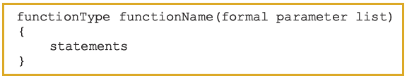
Syntax: Value-Returning Function
Syntax:
functionType is also called the data type or return type

Slide 26
Syntax: Formal Parameter List

Slide 27
Returning a Value from a Function
return statement can be used to return a value from the function to the module that made the function call
Prototype and definition must indicate data type of return value (not void)
Calling function should use return value, e.g.,
assign it to a variable
send it to cout
use it in an arithmetic computation
use it in a relational expression

Slide 28
Returning a Value – the return Statement
Format: return expression;
expression may be a variable, a literal value, or an expression.
expression should be of the same data type as the declared return type of the function (will be converted if not)

Slide 29
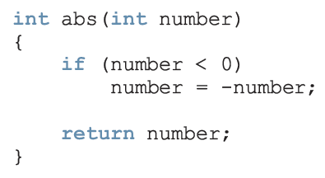
Example of Value-Returning Functions

Slide 30
Value-Returning Functions
Heading: first four properties above
Example: int abs(int number)
Formal Parameter: variable declared in the heading
Example: number
Actual Parameter: variable or expression listed in a call to a function
Example: x = pow(u, v)

Slide 31
Example
//See Example 1.30

Slide 32
Example
//See Example 1.31

Slide 33
Example of Value-Returning Functions (Refer to Gaddis)
// See Example 1.32, Example 1.33, Example 1.34

